Slide 1


Agency NHS Connecting for Health (CFH)
Programme: NHS National Programme for IT (NPfIT)

Slide 2
Introduction
2002 - NHS initiative to develop national IT infrastructure
Goal towards a single, centrally controlled system
Connect 30,000 GPs to 300 Hospitals
Health professionals to have access nationally to patients’ medical records
Originally expected to cost £2.3 billion but in 2006, estimations soared between £12.4bn and 20bn Project dismantled and agency ceased to exist on 31 March 2013 Duties taken over by: Health and Social Care Information Centre, IT systems provider and contractor quasi-autonomous non-governmental organisations

Slide 3
Details of the case
England divided into 5 clusters
Each cluster assigned to a different LSP
Companies contracted
DXC Technology – American
Then Computer Science Corporation
BT Health London
Accenture – withdrew
Fujitsu - Japanese IT supplier - £896 million contract terminated
Contract handed to Cerner Corporation – American health & information technology provider
Additionally, for the national component of the system, the NHS hired: BT Atos Origin Cerner Cable and Wireless

Slide 4
Details of the case - Components
Infrastructure
NHS Spine ----------------------------------------------
NHSmail -------------------------------------------------
National network for the NHS ---------------------
Local Services
Detailed care records systems (Lorenzo)--------
Medical imaging and archiving software --------
A number of applications that underpin the NHS care records service A secure email, text and fax service A broadband network connecting all the sites providing NHS care Accessible to all NHS practitioners as well as patients Ex-rays, medical scans stored and accessible electronically

Slide 5
Details of the case - Components
Removing the need for paper prescription/pharmacy of your choice
Electronic referral and booking service
Summary of patient’s records needed in urgent circumstances
Seamless electronic transfer of records when changing GP
Manages performance and payments of GPs
National applications
Electronic prescribing -----------------------------------
Choose and Book ----------------------------------------
Summary Care Record ----------------------------------
GP record transfer ----------------------------------------
Performance management of primary care -------

Slide 6
Details of the case Among the outcomes, the system promised
non-functional requirements (2005)
Broadband access (>128kbs) to clinician & support staff in the NHS.
bandwidth to minimum - 2Mbps between trusts and across NHS Net Gateways
accessible nationally for out of hours reference
Domain to domain encryption
functional requirements
National Bookings Service
National Prescriptions service
Practitioners to issue reports
Full National Health Record Service
Access and authentication to NHS staff
Provision of e-learning materials
Ambulance Telemonitoring in Ambulances
streamline procurement

Slide 7
Details of the case - Project failure (2008)
Progress reported by NHS own account:
Only 50% of patient appointments are via Choose and Book
86% of GPs made a booking using this method.
4,000 GP practices are regularly using GP record transfer
Less than half of GP practices
Electronic Care Records
Establishment of SNOMED CT (structured clinical vocabulary)
Only small component of this sub-system
Performance Management System partially implemented
Savings vastly overestimated - costs close to 2.bn more than expected

Slide 8
Details of the case - Project failure (2008)
Digital imaging implemented across acute trusts only
337,000 NHS staff are now registered for NHSmail with over 150,000 using the NHSmail system daily.
That’s only %20 of total number of NHS staff
platform needs upgraded to Microsoft Outlook in 2008
The Electronic Prescription Service continues to make steady progress with 64% of GP practices and pharmacies now live
22% of prescriptions being issued electronically
Original delivery due in 2002

Slide 9
Reasons for the software failure
Broad issues
Inaccurate cost estimation
Budgeting
Management incompetence
Sacking of two of the four IT providers
Transparency and accountability
Clash of Culture and context (eg Telemonitoring )
Multisourcing
Contract negotiation
Unfair balance of risk responsibility
Failure to engage with clinicians
Specific failures included
Scope
Lack of planning and technical assessment
Technical Architecture
Project Plan
Detailed design
Lack of Practical value to patients
little clinical functionality
Data security concerns with “fundamental design flaws.”
Delay of crucial deliverables
Implementation and Deployment issues

Slide 10
Consequences of the failure
A huge debt for tax payers
Frustration among MPs, Computer professionals and general public
Legal battles between the NHS and LSPs
Some regional contracts and commitments remained outstanding despite disbursement for the project, on the tax payer’s cost
The NHS claiming back only tiny proportion, the contract provided for, from those who withdraw
Whilst the NPfIT was cancelled, leftover spending would be invested by NHS into local software solutions rather than a single nationally imposed system

Slide 11
Recovery from the failure
Dismantlement of the NPfIT project and NHS body heading it
Rebranding of the NHS body responsible for IT provision in healthcare, to NHS digital ( Health and Social Care Information Centre)
Rethinking its objectives
The set up of new Foundation Trust vs Acute Trusts
have freedom to decide locally how to meet their obligations
are accountable to local people, who can become members and governors
are authorised and monitored by an independent regulator for NHS foundation trusts

Slide 12
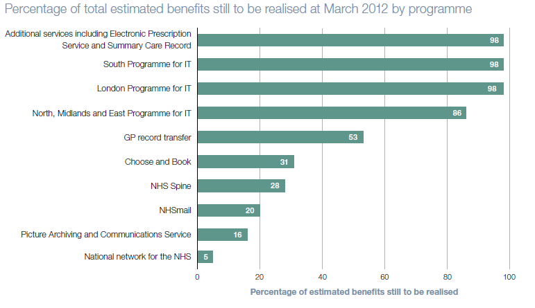
Recovery from the failure
Summery care records – Incidents reported
another 7 million to stabilize it
New effort are focused on the, Spine, record transferee and patients facing services
A new investment of a 13 billion proposal
data gathering and analytics
NHS spine
cyber security centre
led by senior leaders in NHS England and NHS Digital
more focused on supporting trusts to transform themselves.
Audit in June 2013 – High percentage = high faliur

Slide 13
How the failure might have been avoided
More accurate estimate of the scale of the project – Overambitious design
A better engagement with end users
Refusal of the DFH to make "concrete, objective information about NPfIT's progress [...] available to external observers", nor even to MPs”
Decision makers to invest in planning and consultation before rushing to procurement and implement
Better defined responsibilities among various parties involved
Abandoning ruthless standardisation
A better exit strategy
Considering socio-technical issues and pre existing systems

Slide 14
Slide 2: NHS Connecting for Health, Wikipedia. Available at https://en.wikipedia.org/wiki/NHS_Connecting_for_Health . Last edited on 31 October 2018, at 21:35 (Accessed 5/11/2018).
Slide 4: Review of the final benefits statement for programmes previously managed under the National Programme for IT in the NHS, National Audit Office. Available at https://www.nao.org.uk/wp-content/uploads/2013/06/10171-001_NPfiT_Review.pdf. Published June 2013.
Slide 5: Written questions and answers, www.parliament.uk. Sep-Oct 2018. Last modified date not available. Available at https://www.parliament.uk/business/publications/written-questions-answers-statements/written-questions-answers/?house=commons%2clords&keywords=Lorenzo&max=50&member=4244&page=1&questiontype=AllQuestions (Accessed 5/11/2018).
Slide 6 Slide 3: Delivering 21st Century IT Support for the NHS – A National Strategic Programme, How We Started, The National Archives. Available at http://webarchive.nationalarchives.gov.uk/20081105162158/http://www.connectingforhealth.nhs.uk/about/history. Last modified: Monday, 01 September 2008 02:55:24 PM (Accessed 5/11/2018).
Slide 7: Oliver Campion-Awwad, Alexander Hayton, Leila Smith and Mark Vuaran, The National Programme for IT in the NHS A Case History. Available at https://www.cl.cam.ac.uk/~rja14/Papers/npfit-mpp-2014-case-history.pdf. Published February 2014.
Slide 8: Gordon Hextall, NPfIT progress so far. 27/3/2018. Available at https://www.digitalhealth.net/2008/03/npfit-progress-so-far/
Slide 9: Taghreed Justinia, The UK’s National Programme for IT: Why was it dismantled? Available at http://journals.sagepub.com/doi/pdf/10.1177/0951484816662492. Published November 16, 2016.
Slide 13: Christopher Clegg, Craig Shepherd, The biggest computer programme in the world...ever!': Time for a change in mindset?, Journal of Information Technology. Published July 2007. Available at https://www.researchgate.net/publication/220220670_'The_biggest_computer_programme_in_the_worldever'_Time_for_a_change_in_mindset

